Slide 1
Chapter 21
Halliday & Resnick’s Fundamentals of Physics Extended Edition Wiley
Jearl Walker
Electric Charge

Slide 2
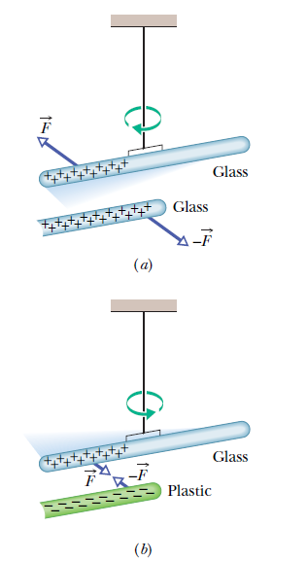
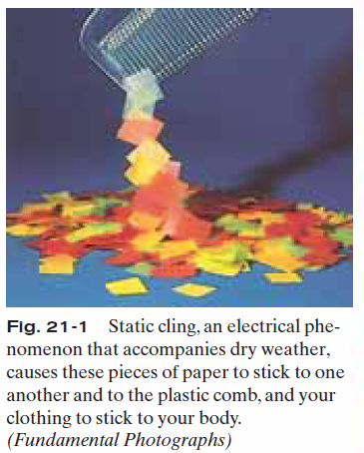
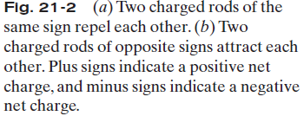

21.2 Electric Charge:

Slide 3
21.3 Conductors and Insulators
Conductors are materials through which charge can move freely; examples include metals (such as copper in common lamp wire), the human body, and tap water.
Nonconductors—also called insulators—are materials through which charge cannot move freely; examples include rubber, plastic, glass, and chemically pure water.
Semiconductors are materials that are intermediate between conductors and insulators; examples include silicon and germanium in computer chips.
Superconductors are materials that are perfect conductors, allowing charge to move without any hindrance.
The properties of conductors and insulators are due to the structure and electrical nature of atoms.
Atoms consist of positively charged protons, negatively charged electrons, and electrically neutral neutrons. The protons and neutrons are packed tightly together in a central nucleus.
When atoms of a conductor come together to form the solid, some of their outermost (and so most loosely held) electrons become free to wander about within the solid, leaving behind positively charged atoms ( positive ions).We call the mobile electrons conduction electrons.
There are few (if any) free electrons in a nonconductor.

Slide 4
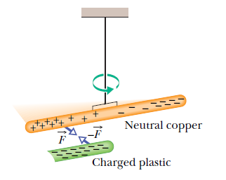
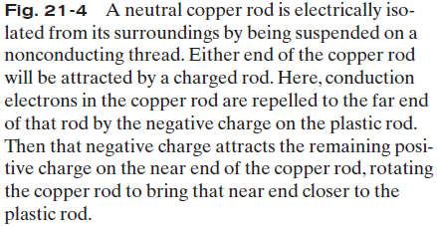
21.3 Conductors and Insulators

Slide 5
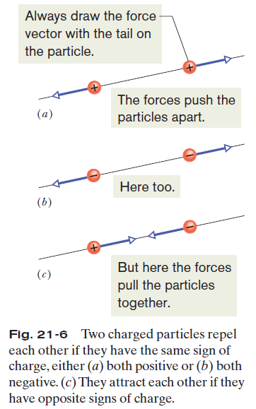


21.4 Coulomb’s Law
This force of repulsion or attraction due to the charge properties of objects is called an electrostatic force.
The equation giving the force for charged particles is called Coulomb’s law:
where particle 1 has charge q₁ and particle 2 has charge q₂, and F is the force on particle 1.
Here iis a unit vector along an axis extending through the two particles, r is the distance between them, and k is a constant.
The SI unit of charge is the coulomb.
The constant
The quantity ε₀ is called the permittivity constant

Slide 6


21.4 Coulomb’s Law
Current is the rate dq/dt at which charge moves past
a point or through a region
in which i is the current (in amperes) and dq (in coulombs) is the amount of charge moving past a point or through a region in time dt (in seconds).
Therefore,

Slide 7
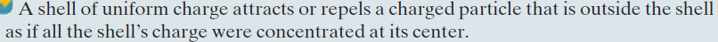
21.4 Coulomb’s Law
If there are n charged particles, they interact independently in pairs, and the force on any one of them, say particle 1, is given by the vector sum
in which, F_{1,4} is the force acting on particle 1 due to the presence of particle 4, etc.
As with gravitational force law, the shell theorem has analogs in electrostatics:

Slide 8
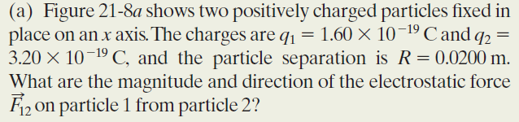
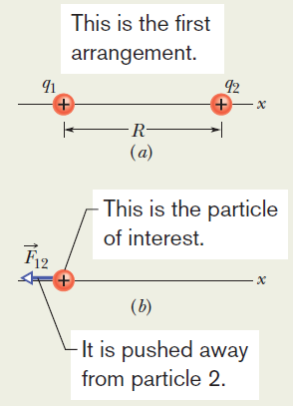
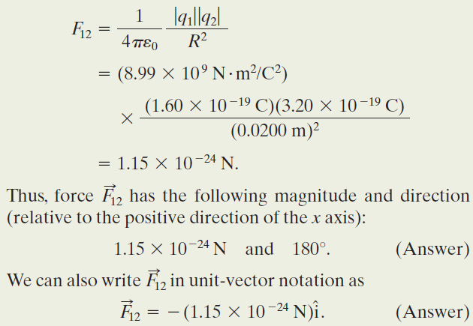
Example, The net force due to two other particles:
Fig. 21-8 (a) Two charged particles of charges q₁ and q₂ are fixed in place on an x axis. (b) The free-body diagram for particle 1, showing the electrostatic
force on it from particle 2.

Slide 9
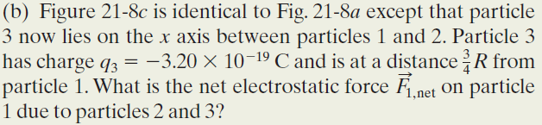
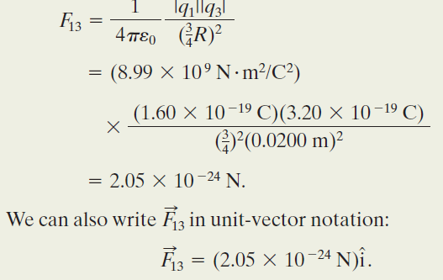
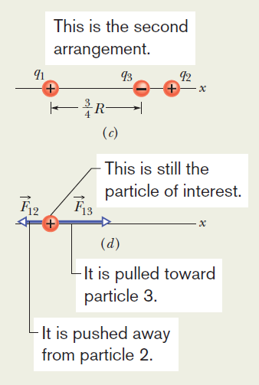
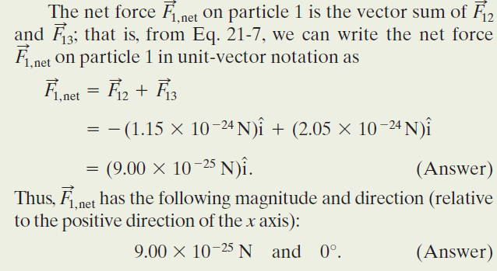
Example, The net force due to two other particles, cont.:
Fig. 21-8 (c) Particle 3 included. (d) Free-body diagram for particle 1.

Slide 10
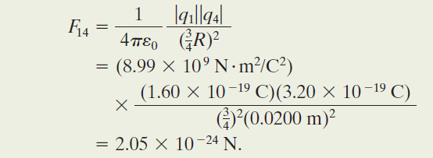
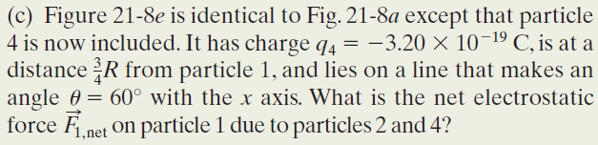
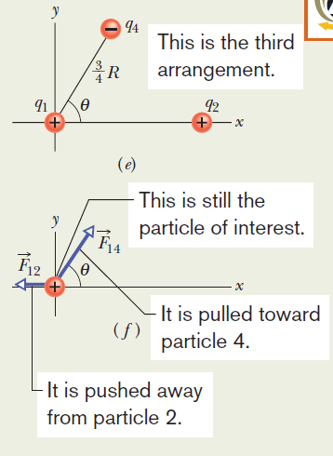
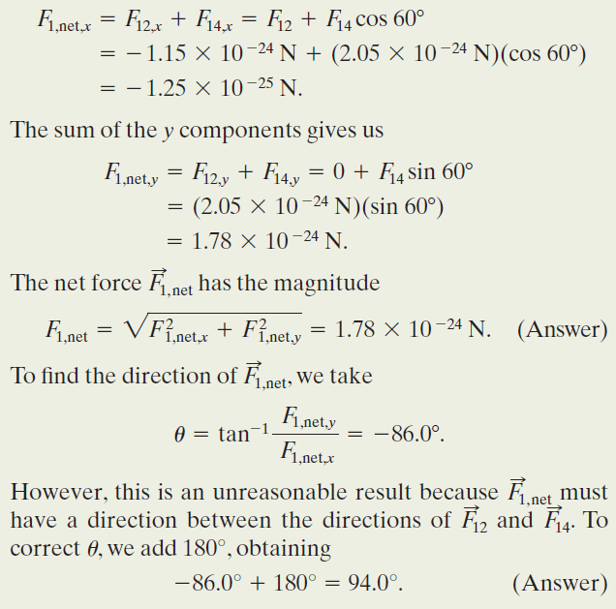
Example, The net force due to two other particles, cont.:
Fig. 21-8 (e) Particle 4 included. (f ) Freebody diagram for particle 1.

Slide 11
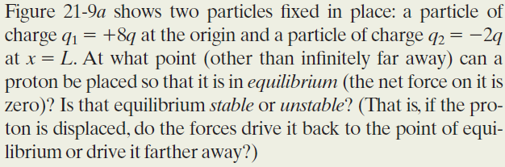


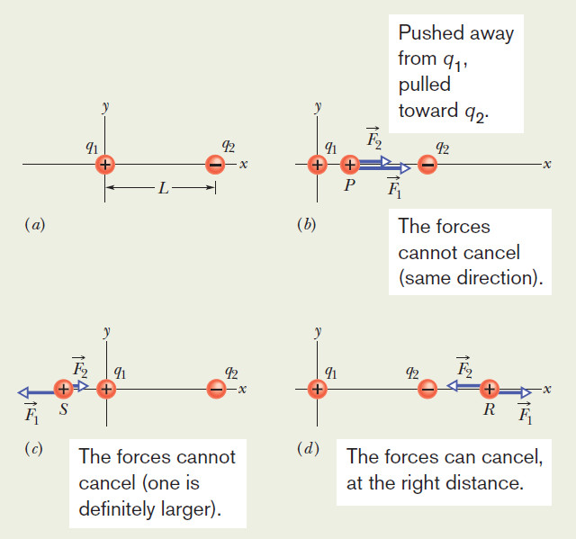
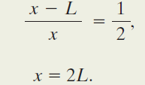
Example, Equilibrium of two forces:
The equilibrium at x=2Lis unstable; that is, if the proton is displaced leftward from point R, then F₁ and F₂ both increase but F₂ increases more (because q₂ is closer than q₁), and a net
force will drive the proton farther leftward. If the proton is displaced rightward, both F₁ and F₂ decrease but F₂ decreases more, and a net force will then drive the proton farther rightward. In a stable equilibrium, if the proton is displaced slightly, it returns to the equilibrium position.

Slide 12
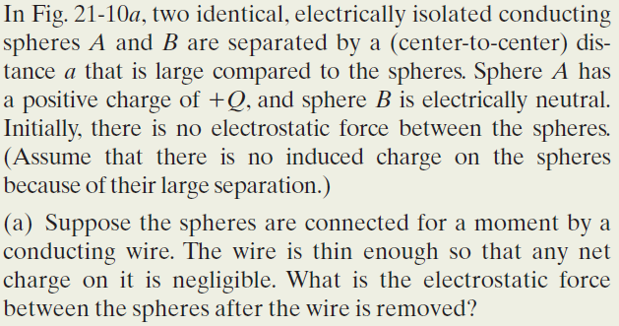
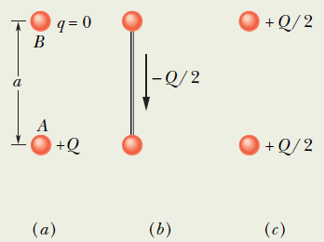

Example, Charge Sharing:
(1) Since the spheres are identical, connecting them means that they end up with identical charges (same sign and same amount). (2) The initial sum of the charges (including the signs of the charges) must equal the final sum of the charges.
Reasoning: When the spheres are wired together, the (negative) conduction electrons on B move away from one another (along the wire to positively charged A— Fig. 21-10b.)
As B loses negative charge, it becomes positively charged, and as A gains negative charge, it becomes less positively charged. The transfer of charge stops when the charge on B has increased to Q/2 and the charge on A has decreased to Q/2, which occurs when Q/2 has shifted from B to A.
The spheres, now positively charged, repel each other.
Fig. 21-10 Two small conducting spheres A and B. (a) To start, sphere A is charged positively. (b) Negative charge is transferred from B to A through a connecting wire. (c) Both spheres are then charged
positively.

Slide 13

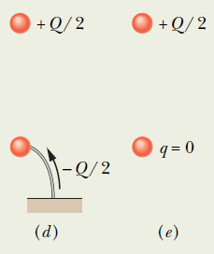
Example, Charge Sharing, cont.:
Reasoning: When we provide a conducting path between a charged object and the ground (which is a huge conductor), we neutralize the object.
Were sphere A negatively charged, the mutual repulsion between the excess electrons would
cause them to move from the sphere to the ground.
However, because sphere A is positively charged, electrons with a total charge of Q/2 move from the ground up onto the sphere (Fig. 21-10d), leaving the sphere with a charge of 0 (Fig. 21-10e). Thus, there is (again) no electrostatic force between the two spheres.
Fig. 21-10 (d) Negative charge is transferred through a grounding wire to sphere A. (e) Sphere A is then neutral.

Slide 14
21.5 Charge is Quantized
Since the days of Benjamin Franklin, our understanding of
of the nature of electricity has changed from being a type of
‘continuous fluid’ to a collection of smaller charged particles.
The total charge was found to always be a multiple of a certain
elementary charge, “e”:
The value of this elementary charge is one of the fundamental
constants of nature, and it is the magnitude of the charge
of both the proton and the electron. The value of “e” is:
.

Slide 15
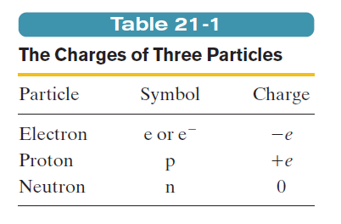
21.5 Charge is Quantized
Elementary particles either carry no charge, or carry a single
elementary charge. When a physical quantity such as charge
can have only discrete values, rather than any value, we say
the quantity is quantized. It is possible, For example, to find
a particle that has no charge at all, or a charge of +10e, or -6e,
but not a particle with a charge of, say, 3.57e.

Slide 16
21.5 Charge is Quantized
Many descriptions of electric charge use
terms that might lead you to the conclusion
that charge is a substance. Phrases like:
“Charge on a sphere”
“Charge transferred”
“Charge carried on the electron”
However, charge is a property of particles,
one of many properties, such as mass.

Slide 17
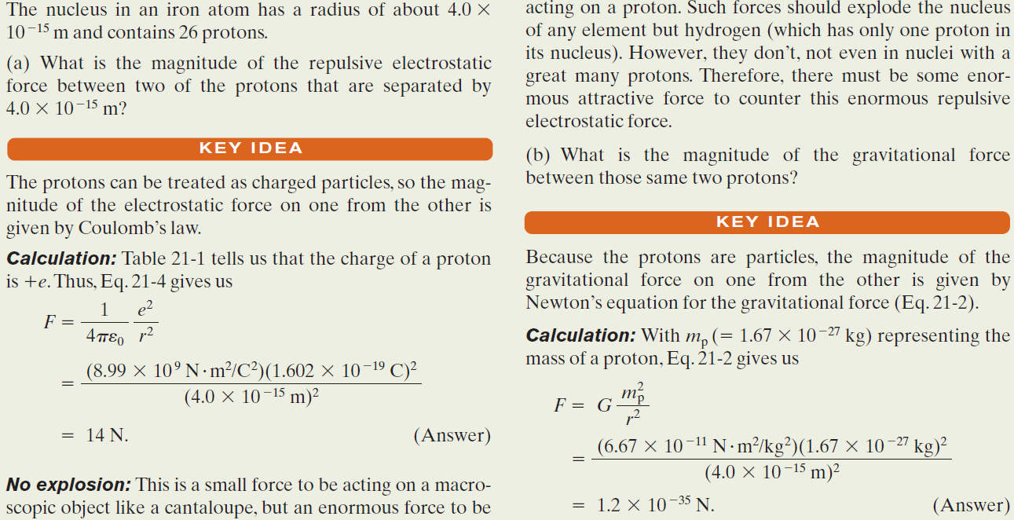
Example, Mutual Electric Repulsion in a Nucleus:

Slide 18


21.6 Charge is Conserved
If one rubs a glass rod with silk, a positive charge appears on the rod. Measurement shows that a negative charge of equal magnitude appears on the silk. This suggests that rubbing does not create charge but only transfers it from one body to another, upsetting the electrical neutrality of each body during the process.
This hypothesis of conservation of charge has stood up under close examination, both for large-scale charged bodies and for atoms, nuclei, and elementary particles.
Example 1: Radioactive decay of nuclei, in which a nucleus transforms into (becomes) a different type of nucleus.
A uranium-238 nucleus (²³⁸U) transforms into a thorium- 234 nucleus (²³⁴Th) by emitting an alpha particle. An alpha particle has the same makeup as a helium-4 nucleus, it has the symbol ⁴He. Here the net charge is 238.
Example 2: An electron e (charge -e) and its antiparticle, the positron e (charge +e), undergo an annihilation process, transforming into two gamma rays (high-energy light):. Here the net charge is zero.
Example 3: A gamma ray transforms into an electron and a positron. Here the net charge is again zero.

Slide 19
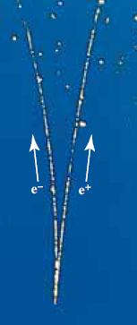
A photograph of trails of bubbles left in a bubble chamber by an electron and a positron. The pair of particles was produced by a gamma ray that entered the chamber directly from the bottom.
Being electrically neutral, the gamma ray did not generate a telltale trail of bubbles along its path, as the electron and positron did.
(Courtesy
Lawrence Berkeley Laboratory)
In the annihilation process, the net charge of the system is zero both before and after the event. Charge
is conserved.
In pair production, the converse of annihilation, charge is also conserved.

Slide 20
Photograph shows such a pair-production event that occurred in a bubble chamber.
A gamma ray entered the chamber from the bottom and at one point transformed into an electron and a positron.
Because those new particles were charged and moving, each left a trail of tiny bubbles.
The trails were curved because a magnetic field had been set up in the chamber.)

